Slide 1
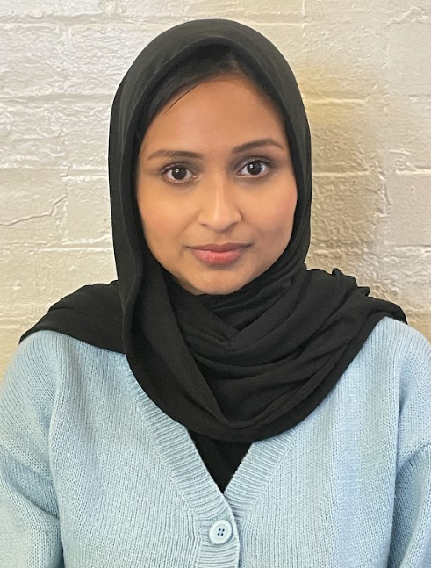
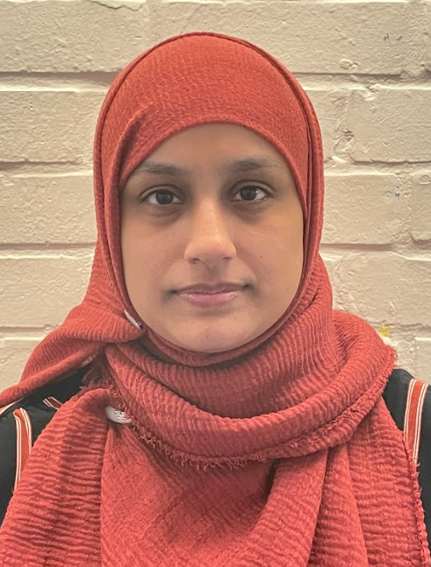
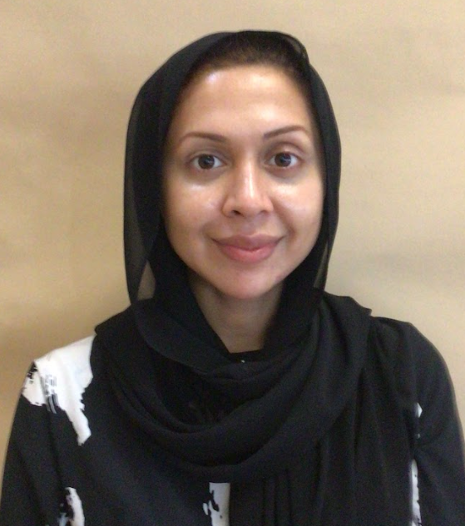
Welcome to Year 4
Tashrifa
Tahmina
Najache
Lena

Slide 2
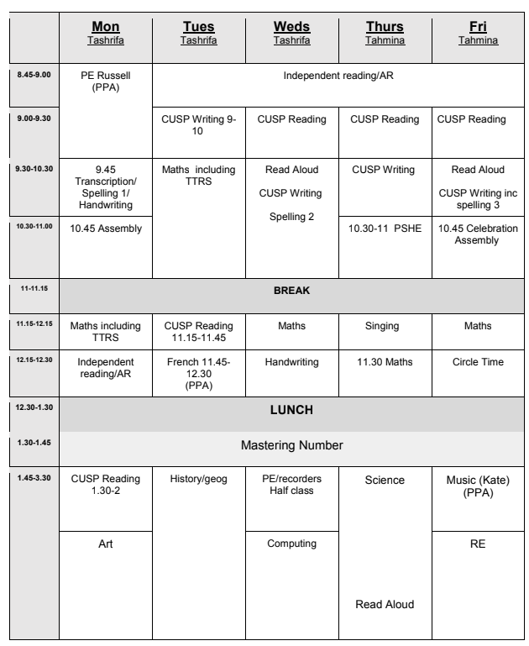
Timetable
Notes:
Talk through each day briefly

Slide 3
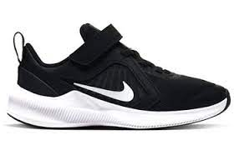
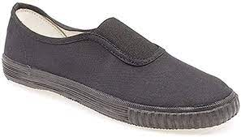
PE Days for the autumn term:
Monday 8:45 am - 9:45 am
Wednesday 1:30 pm - 2:30 PM
There will be 2 PE lessons a week.
One-Way Change:
On PE days your child needs to come to
Mondays: come in wearing their PE kit and bring their uniform in a bag to change into.
Wednesdays: come in uniform, bring their PE kit in a bag. They will come home in their PE kit and bring their uniform in a bag.
PE
This is the school PE kit:
T- shirt
Shorts / leggings
Trainers or plimsolls
Notes:
Tashrifa

Slide 4
Homework
Reading
30-40 mins every day
Accelerated Reader
Spelling
Weekly sheet
Maths
White Rose Maths Journal
Times Tables Rock Stars / Power Maths games
Family homework
Variety of tasks
Celebrated in school
How to support at home
See parent curriculum booklet for ideas.
Notes:
Tahmina

Slide 5
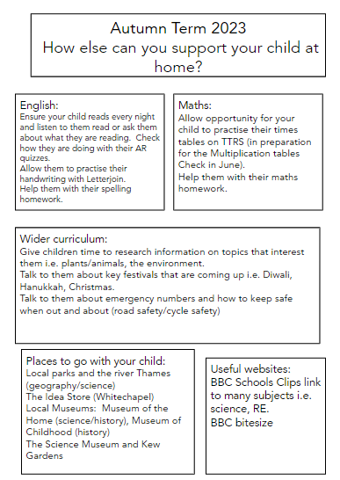
This booklet contains information about what your child will be learning in the Autumn term for each subject.
Curriculum
Notes:
Tashrifa

Slide 6
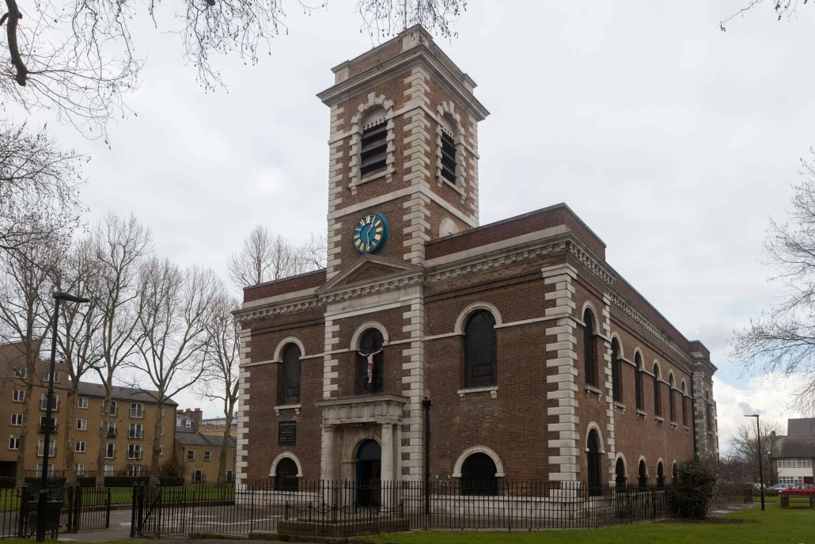
Trips/Experiences
Wednesday 20th September:
Greenwich River Thames visit linked to Geography
Mapping the river thames
Identifying the features (source, mouth, the journey)
Remember: Appropriate clothing
Monday October 2nd:
Greenwich- Living things workshop linked to Science
Identifying animal groups
Meadow sweeping
Remember: Appropriate clothing
Local Trips:
Visit to St Matthews Church
Link to English and RE: How the church serves the community and prepares for Christmas.
Notes:
Tashrifa- Geog trip
Tahmina- Science + RE trip

Slide 7
How to communicate with the class teacher
If you have any concerns or need a more detailed conversation please request a time to see the class teacher either at the end of the day or by calling the school office.
See the teacher in the playground at the end of the day for informal chat/quick messages.
Questions?
Notes:
Tashrifa

Slide 8
Questions?

